Slide 1

INSTITUTE - UIE
DEPARTMENT- ACADEMIC UNIT-2
Bachelor of Engineering (Computer Science & Engineering)
Subject Name: Introduction to Problem Solving
Code:22CSH-101
Structure of C program
DISCOVER . LEARN . EMPOWER

Slide 2


Introduction to Problem Solving
Course Objectives
The course aims to provide exposure to problem-solving through programming.
The course aims to raise the programming skills of students via logic building capability.
With knowledge of C programming language, students would be able to model real world problems.

Slide 3


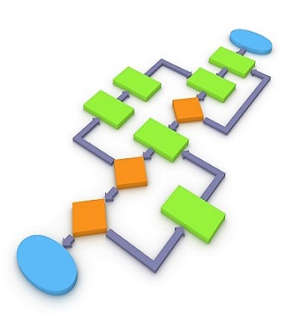
Course Outcomes
CO Number | Course Outcome
CO1 | Remember the concepts related to fundamentals of C language, draw flowcharts and write algorithm/pseudocode.
CO2 | Understand the way of execution and debug programs in C language.
CO3 | Apply various constructs, loops, functions to solve mathematical and scientific problem.
CO4 | Analyze the dynamic behavior of memory by the use of pointers.
CO5 | Design and develop modular programs for real world problems using control structure and selection structure.

Slide 4
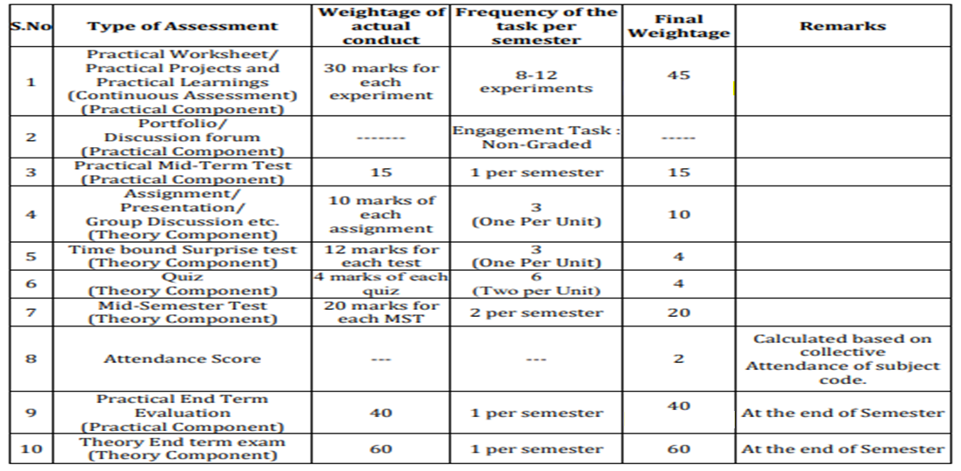
Scheme of Evaluation

Slide 5
What is C ??
C is a structured programming language. It was initially developed by Dennis Ritchie in the year 1972. It was mainly developed as a system programing language to write an operating system.
Why C??
Newer languages like java, python offer more features than c programming language but due to additional processing, their performance rate gets down effectively. C programming language as the been middle-level language provides programmers access to direct manipulation with the computer hardware but higher-level languages do not allow this. That’s the reasons C language is considered as the first choice to start learning programming languages.

Slide 6
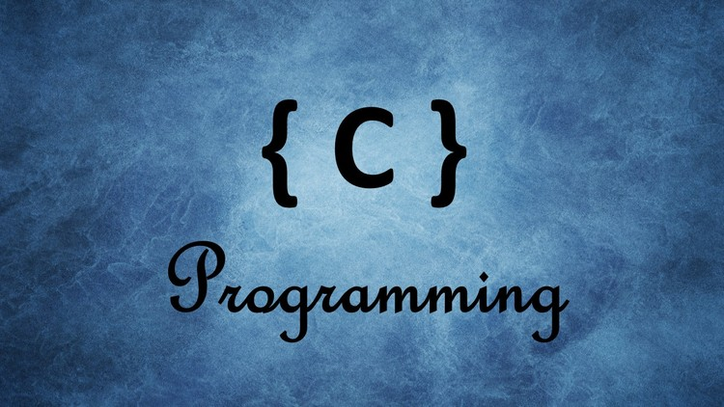
CONTENTS
Structure of C program
Compilation and Execution process
Program demonstration
Notes:
Computer in the diagram is 3rd generation computer. The period of third generation was from 1965-1971. The computers of third generation used Integrated Circuits (ICs) in place of transistors. A single IC has many transistors, resistors, and capacitors along with the associated circuitry. The main features of third generation are −
IC used
More reliable in comparison to previous two generations
Smaller size
Generated less heat
Faster
Lesser maintenance
Costly
AC required
Consumed lesser electricity
Supported high-level language

Slide 7
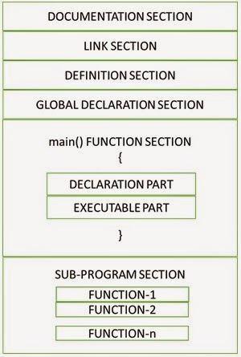
Structure of C program
Structure of C program is defined by set of rules called protocol, to be followed by programmer while writing C program. All C programs are having sections/parts which are mentioned here.

Slide 8
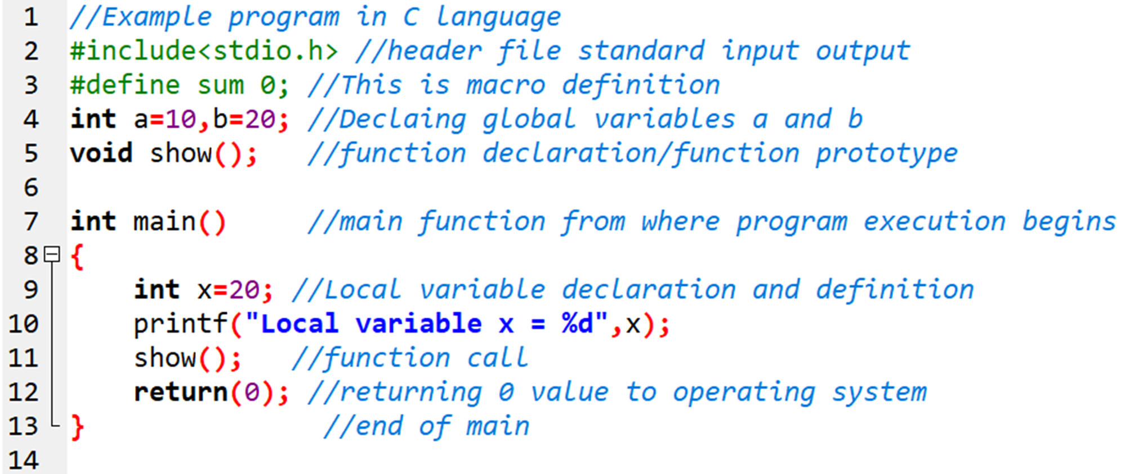
STRUCTURE OF C PROGRAM- EXAMPLE
Sample text here (16)
Figure 2.3. Program 1 (executed on Dev-C++ IDE)

Slide 9
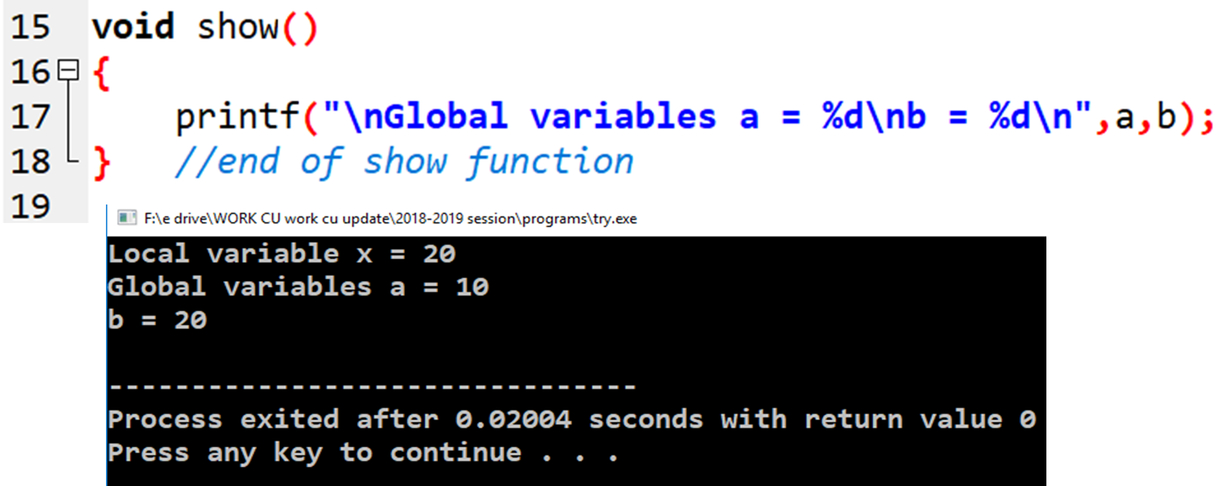
STRUCTURE OF C PROGRAM- EXAMPLE
Figure 2.4. Program 1 output (executed on Dev-C++ IDE)

Slide 10
ü Documentation Section
The documentation section consists of a set of comment lines, giving the name of the program, the author and other details, which the programmer would like to use later. The comments can be written in two ways:
a) Multi-line comment
/* This is a
multi-line
comment */
Ex: /* Author : Aman
Date:10/06/2020 */
b) Single-line comment
// This is a single-line comment
// Author: Aman

Slide 11
ü Link Section
The link section provides instructions to the compiler to link functions from the system library.
If we want to access the functions stored in the library, it is necessary to tell the compiler about the files to be accessed. This is achieved by using the preprocessor directive #include as follows:
#include<filename>
where filename is the name of the library file that contains the required function definition. Preprocessor directives are placed at the beginning of the program. Some of the examples are:
#include<stdio.h>
#include<conio.h>
#include<math.h>

Slide 12
ü Definition Section
The definition section defines all symbolic constants.
A #define is a preprocessor compiler directive and not a statement. Therefore #define lines should not end with a semicolon.
Symbolic constants are usually written in uppercase so that they are easily distinguished from lowercase variable names.
e.g. #define YEAR 2014
#define PI 3.14
ü Global Declaration Section
There are some variables that are used in more than one function. Such variables are called global variables and are declared in the global declaration section.
This section also declares all the user-defined functions.

Slide 13
ü main( ) Function Section
Every C program must have one main( ) function section. This section contains two parts, declaration part and executable part.
The declaration part declares all the variables used in the executable part.
These two parts must appear between the opening and the closing braces.
The program execution begins at the opening brace and ends at the closing brace. The closing brace of the main function section is the logical end of the program.
All the statements in the declaration and executable parts end with a semicolon (;).

Slide 14
ü Subprogram Section
The subprogram section contains all the user-defined functions that are called in the main functions. User-defined functions are generally placed immediately after the main function, although they may appear in any order.

Slide 15


Rules to write c program
All C statements must end with semicolon.
C is case-sensitive. That is, upper case and lower case characters are different. Generally the statements are typed in lowercase.
C statement can be written in one line or it can split into multiple lines.
Braces must always match upon pairs, i.e., every opening brace { must have a matching closing brace }.
Every C program starts with main() function.

Slide 16
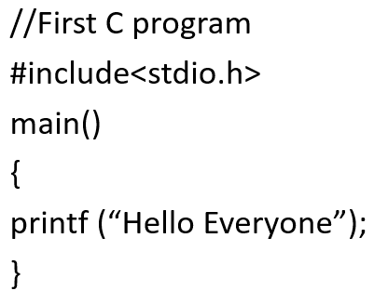
First example program:
Documentation
Pre-processor directive
main function
Begin
Main function body
End
Statement

Slide 17
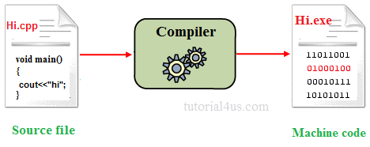
Need of compiler:

Slide 18
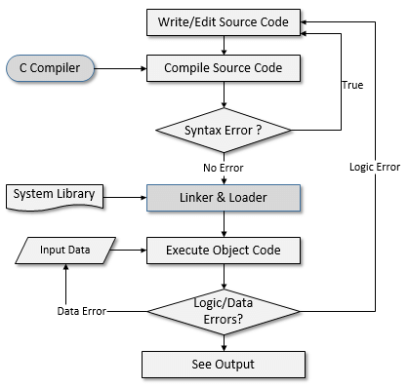
Compilation & Execution process
File1.c
File1.i
File1.o or File1.obj
File1.exe
Final output

Slide 19
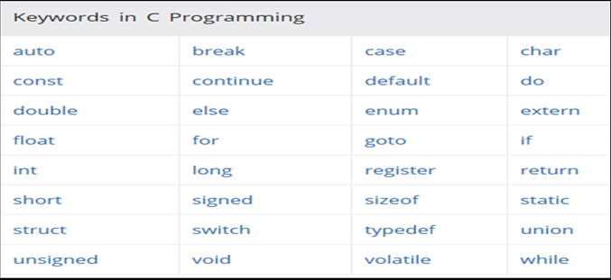
KEYWORDS IN C

Slide 20
Summary
In this tutorial we have seen the structure of C program, how to design a c program including preprocessor directives, global declaration, main function and some user defined functions.
We have discussed the importance of header files in a program , the definition of predefined functions is stored in header files.
We have discussed about the compilation and execution process, compiler translate the c source code into machine code.
At the end we have seen the live demonstration to design a code in C, Source code must be saved in →Hello.c then converted into →hello.i→hello.obj→hello.exe→Output

Slide 21
Frequently Asked question
Q1 Differentiate compiler and interpreter.
Compiler transforms code written in a high-level programming language into the machine code, at once, before program runs, whereas an Interpreter coverts each high-level program statement, one by one, into the machine code, during program run. Compiled code runs faster while interpreted code runs slower.
Q2 what is the need of preprocessing ?
The C preprocessor is the macro preprocessor for the C programming language. The preprocessor provides the ability for the inclusion of header files, macro expansions, conditional compilation, and line control. In many C implementations, it is a separate program invoked by the compiler as the first part of translation.

Slide 22
Assessment Questions:
Q Choose the correct option
Q1 Role of Linker is:
Link with compiler
Link with system libraries
Link with assembler
generate output
Q2 After compilation which file is created
file.c
file.obj
file.exe
file.I
Q3 Which of the following is type of an error:
Syntax error
Logic error
Data error
All above
Q4 Correct documentation syntax is:
/ hello world program /
// hello world program
//* hello world program
// hello world program //

Slide 23
Q5 Explain the role of pre-processor.
Q6 What is the need of compilation?
Q7 Design a program to display your details including name, Father’s name and grades in 12th.
Q8 Discuss the need of main function in program.
True/False
Q9 Header file contains definition of predefined functions
Q10 Termination symbol is optional for statements written in main()
T/F

Slide 24
Discussion forum.
Future Scope of C
https://www.youtube.com/watch?v=5Kg4q0Vq5UU
Students, have a look at this video and mention your views in BB classroom

Slide 25

REFERENCES
Reference Books:
[1] Programming in C by Reema Thareja.
[2] Programming in ANSI C by E. Balaguruswamy, Tata McGraw Hill.
[3] Programming with C (Schaum's Outline Series) by Byron Gottfried Jitender Chhabra, Tata McGraw Hill.
[4] The C Programming Language by Brian W. Kernighan, Dennis Ritchie, Pearson education.
Website:
fresh2refresh.com. C Language - Learn C Programs From Basics | Fresh2Refresh. [online] Available at: https://fresh2refresh.com/c-programming/c-basic-program/
GeeksforGeeks. C Language Introduction - GeeksforGeeks. [online] Available at: https://www.geeksforgeeks.org/c-language-set-1-introduction/
Video Links:
NPTEL https://www.youtube.com/watch?v=VSU7EaHMzl8&list=PLJvIzs_rP6R73WlvumJvCQJrOY3U5zq1j&index=5&t=615s

Slide 26
THANK YOU

